Slide 1
SUPPLY CHAIN
OPTIMIZATION
Pankhuri Jain
23030124029
Marjari Pusadkar
23030124031
Sanchi Mittal
23030124265

Slide 2


01 | Problem Definition
02 | Technology used
03 | Flowchart
04 | Data Collection
05 | Understanding and preprocessing
06 | Analytics
07 | Model selection
08 | ML/Time series
09 | Model training
10 | Optimization
11 | Visualization
12 | Conclusion
Agenda

Slide 3
PROBLEM DEFINITION
Supply Chain Optimisation focuses on improving the efficiency of product flow from suppliers to customers. In this project, we analyse sales and inventory data to improve demand forecasting and optimise stock levels. The goal is to reduce costs and ensure smooth operations. By using data-driven insights, we help the business make smarter supply chain decisions.
Expected Business Impact
Business Challenge
Project Objective
  Inefficient demand forecasting
  Poor inventory planning across locations
  Lack of data-driven decision-making
  Optimise supply chain operations
  Improve demand prediction accuracy
  Ensure timely product availability
  Lower operational costs
  Faster replenishment cycles
  Improved profitability
  Better customer satisfaction
3

Slide 4

TECHNOLOGY USED
MATPLOTLIB
NUMPY
PYTHON
PANDAS
JENKINS
SCIKIT LEARN
SEABORN
4

Slide 5


FLOWCHART
Visualisation
DATA COLLECTION
Stock Sufficiency
DATA PREPROCESSING
Data understanding
Prediction
Feature Engineering
Model training
Model Selection- Random Forest regressor
5

Slide 6
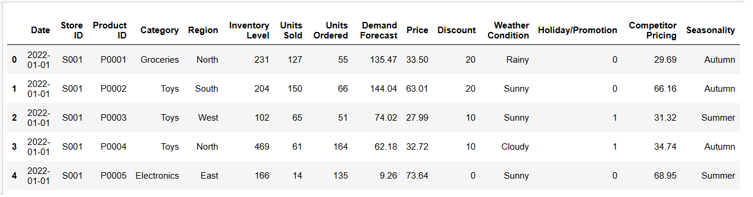
DATA COLLECTION
  The dataset was sourced from Kaggle and contains retail inventory and sales data.
  The dataset is deemed suitable for analyzing demand forecasting and supply chain optimization.
  df.head() displays the first 5 records of the dataset.
  It helps in understanding column names, data structure, and sample values.
6

Slide 7
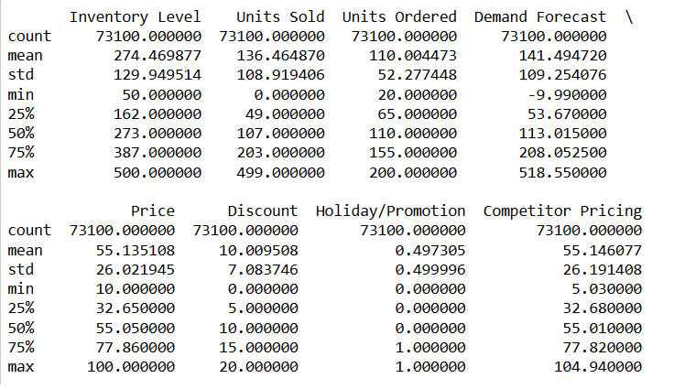
UNDERSTANDING & PRE-PROCESSING
  After running df.describe(), we observe that the dataset contains 73,100 records with no missing values in the numerical columns.
  The average inventory is 274 units, while the average sales are 136 units, indicating that stock is generally higher than sales.
  The average demand forecast (141) is close to actual sales.
7

Slide 8
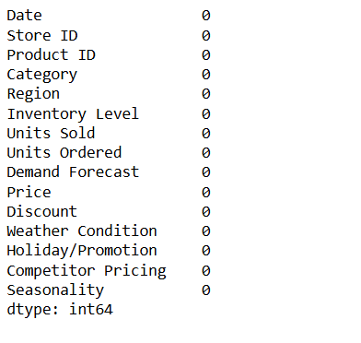
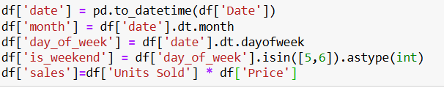
UNDERSTANDING & PRE-PROCESSING
  After applying df.isnull().sum(), we found that all columns show 0 missing values.
  This means the dataset is complete and clean, with no data gaps.
  Therefore, no missing value handling or imputation is required during preprocessing.
8

Slide 9
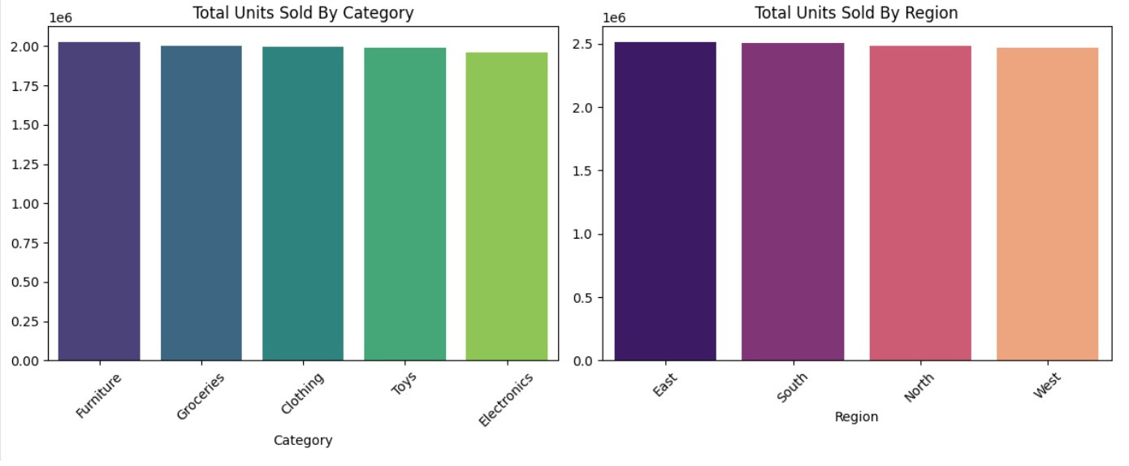
ANALYTICS
From the analysis, we observe that product demand is evenly spread across categories and regions. There are no significant demand spikes or shortages in any specific area. This indicates a stable supply chain structure. Minor optimizations in high-performing categories and regions can further improve efficiency.
9

Slide 10
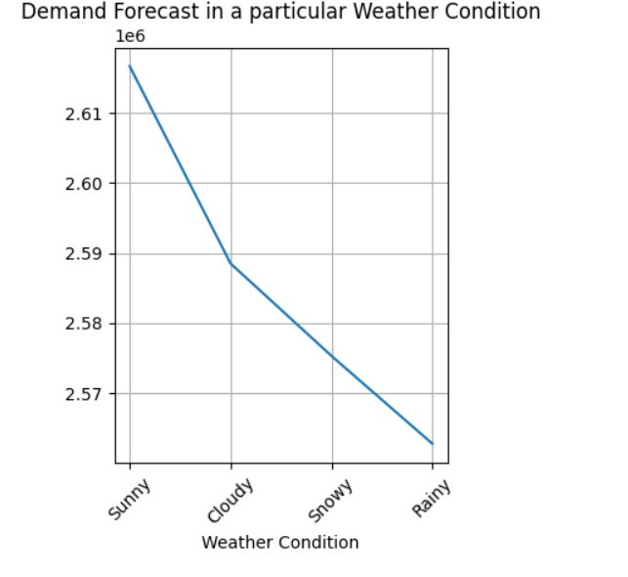
ANALYTICS
Key Observations
  Taking into consideration of external forces
  Demand is highest during Sunny weather conditions.
  Demand further drops during Snowy conditions.
  Rainy weather shows the lowest demand among all conditions.
This indicates a negative trend in demand as weather conditions become less favorable.
10

Slide 11
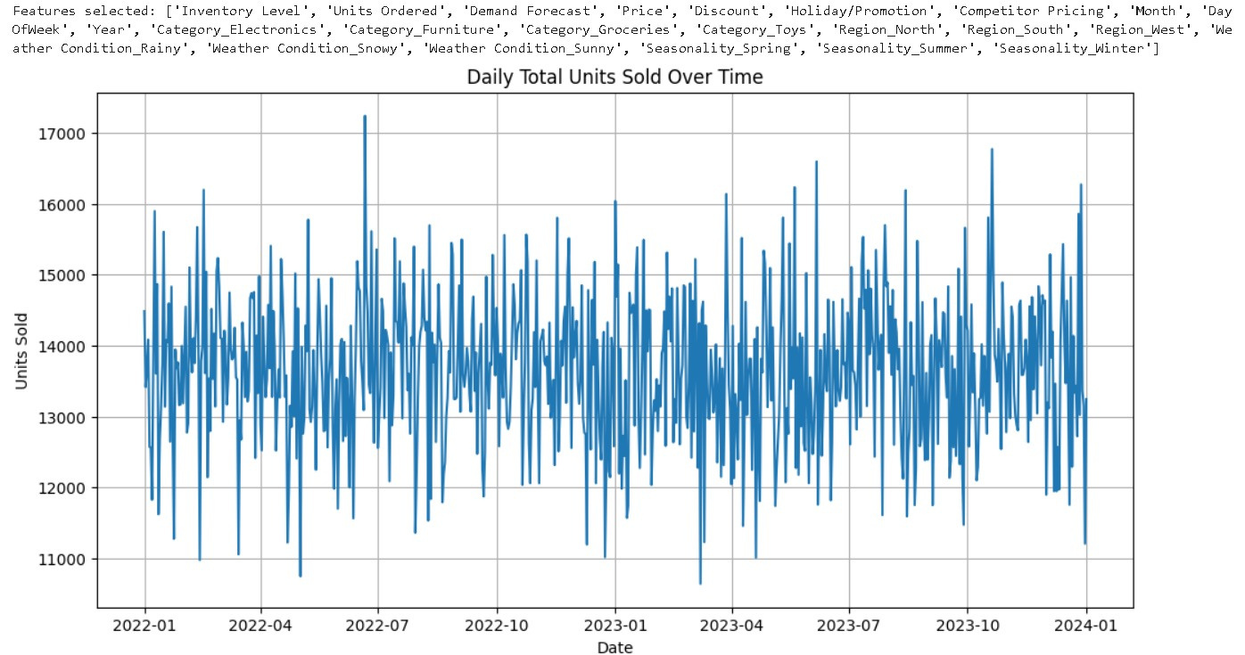
MACHINE LEARNING / TIME SERIES
11

Slide 12
MODEL SELECTION
Chosen Algorithm: Random Forest Regressor
For this project, we selected the Random Forest Regressor algorithm to build our prediction model. Random Forest Regressor is an Machine learning algorithm used to predict continuous numeric values and builds many decision trees and takes the average of their predictions to produce the final output.
Relevance to Supply Chain Optimization
Random Forest Regressor helps in accurately predicts continuous variables such as demand, lead time and cost by handling complex and non linear relationships in supply chain data.This helps in improving inventory planning, cost control and overall operational efficiency.
Role in Supply Chain Optimization
By using Random Forest Regressor, we can predict product demand more precisely, which helps reduce stockouts, avoid overstocking, and improve overall supply chain efficiency.
12

Slide 13
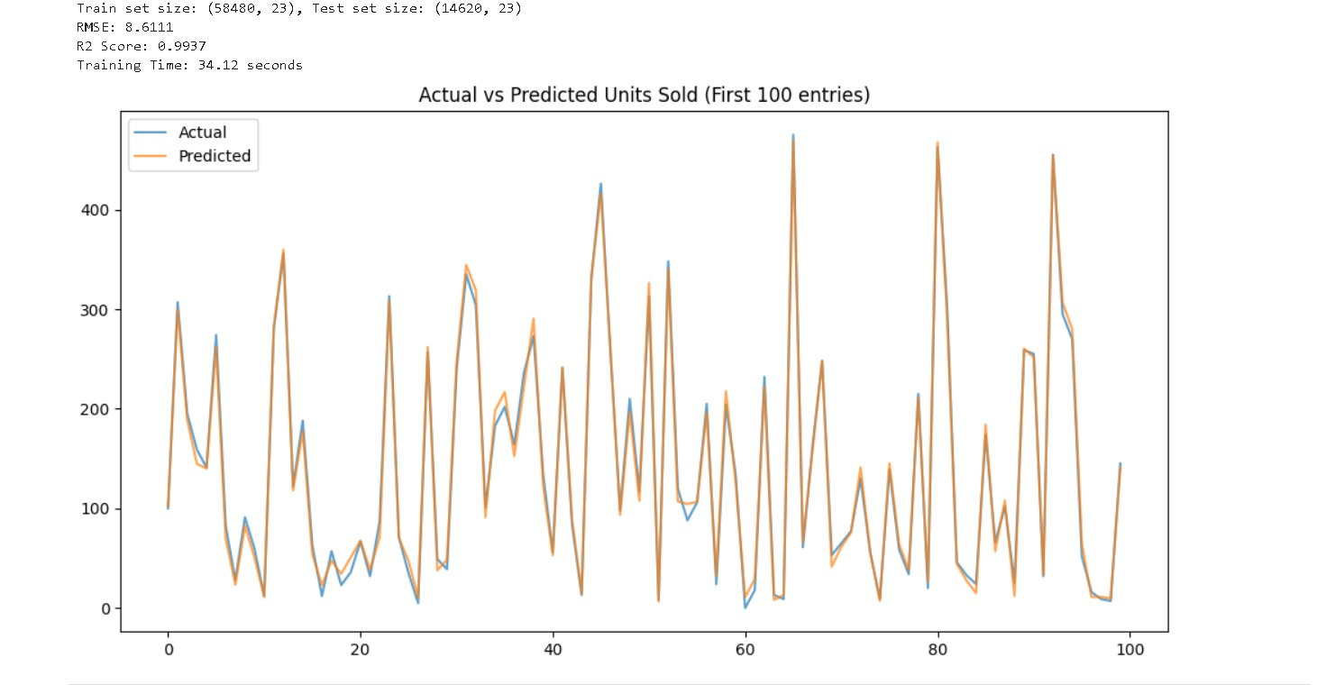
RMSE SCORE:8.6111
R2 SCORE:0.9937
MODEL TRAINING
13

Slide 14
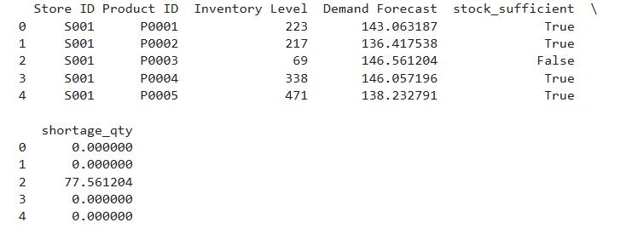
OPTIMIZATION
  Inventory Level represents the current quantity of products available in the store.
  Demand Forecast shows the aggregated mean demand forecast.
  Stock_Sufficient is a logical indicator (True/False) that shows whether the current inventory can meet forecasted demand.
  Shortage_Qty calculates the additional quantity required when inventory is lower than predicted demand.
14

Slide 15
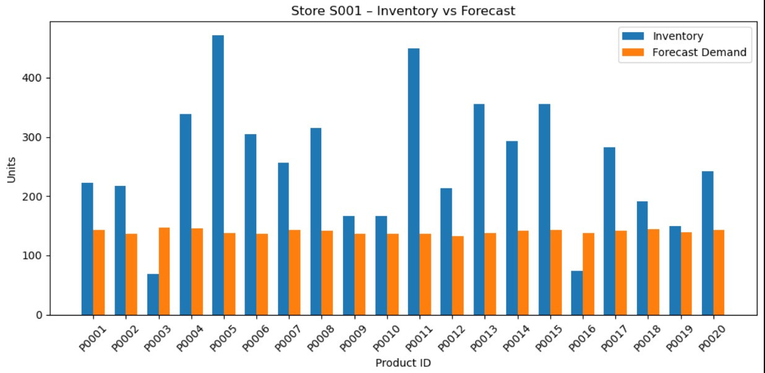
OPTIMIZATION & VISUALIZATION
15

Slide 16
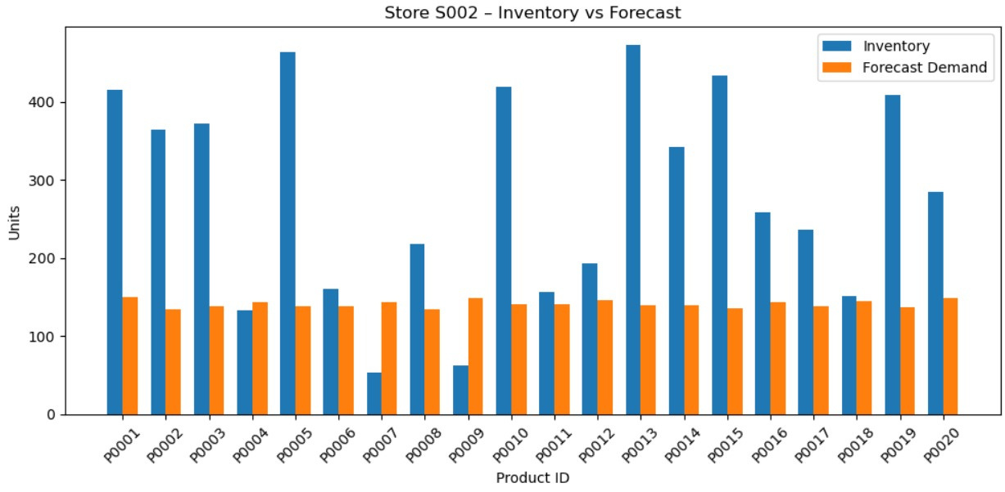
OPTIMIZATION & VISUALIZATION
16

Slide 17
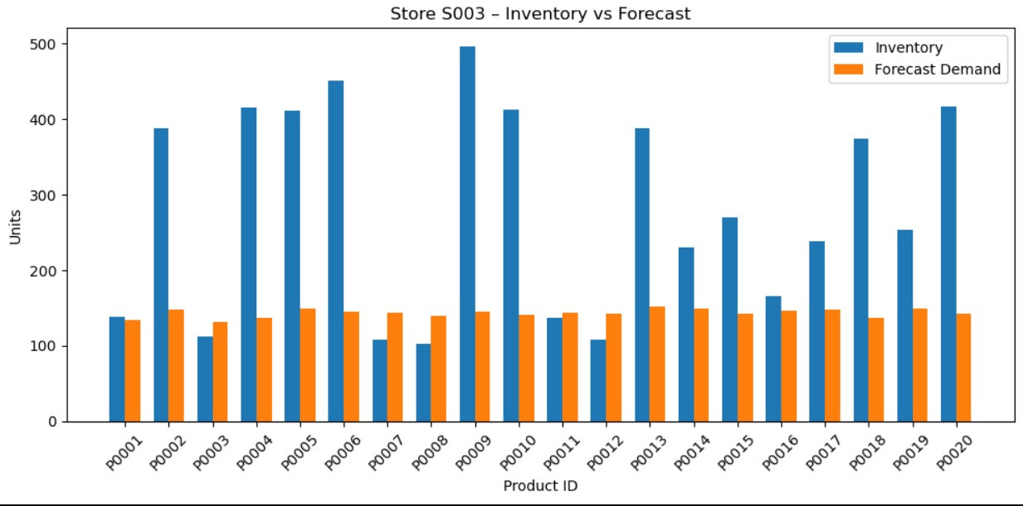
OPTIMIZATION & VISUALIZATION
17

Slide 18
CONCLUSION
This project focused on optimising supply chain operations by integrating demand forecasting with inventory analysis. Using a real-world retail dataset, we conducted data understanding, preprocessing, feature engineering, and exploratory data analysis to identify demand patterns across categories, regions, and external factors such as weather conditions.
A Random Forest Regressor model was implemented to accurately forecast product demand. The model demonstrated excellent predictive performance with a high R² score (~0.99) and low RMSE (~8.61), indicating strong reliability and minimal prediction error.
18

Slide 19
ACKNOWLEDGEMENT
We sincerely acknowledge Mr. Vikas Choudhary Sir for giving us the opportunity to work on this project and for his valuable guidance throughout the process.
His support and encouragement helped us successfully complete this project and enhance our learning experience.
19

Slide 20
REFERENCES
  Dataset: https://www.kaggle.com/datasets/programmer3/retail-and-supply-chain-operations-data
  Github repository: https://github.com/Pankhuri1709/Open-Sources-Tools-Project
20

Slide 21
THE END
THANK YOU FOR LISTENING
Pankhuri Jain
23030124029
Marjari Pusadkar
23030124031
Sanchi Mittal
23030124265

